Slide 1
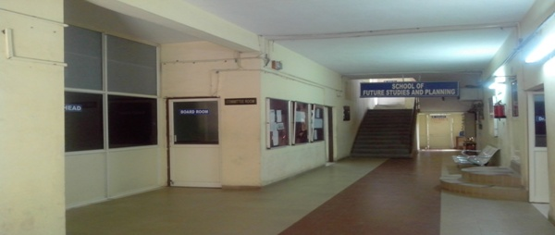
DEVI AHILYA VISHWAVIDYALAYA
SCHOOL OF FUTURE STUDIES AND PLANNING

Slide 2
About School
Established in 1990 to run UGC’s innovative programme in Future Studies.
Futures studies is an interdisciplinary field, studying past and present changes, and aggregating and analyzing both lay and professional strategies and opinions with respect to future.
It includes analyzing the sources, patterns, and causes of change to develop foresight and to map possible futures.
Academic Programmes:
M.Tech. in Future Studies and Planning
M.Tech. in Systems Management
Ph.D. in interdisciplinary areas.

Slide 3
Vision
School of Future Studies and Planning strives to become a globally reputed academic and research centre in the areas of futures studies by offering excellent interdisciplinary academic programmes and research activities applicable to diverse systems.

Slide 4
Mission
The mission of School of Future Studies and Planning is to support the organizations in designing policies, Strategic Planning, and development of quality products/services. To realize this mission school:
Enriches the students with a set of skills, knowledge and attitudes that permits them to succeed and thrive as futurist and system engineer.
Prepares its student to pursue life-long learning, serve the profession and meet the challenges.
Conducts inter-disciplinary research studies, develops scenarios and policies.
Provides consultancy services.

Slide 5
Objectives
To understand the nature of global change, its rapid pace, and its ever increasing complexity.
To understand the forces and trends that shape the future.
To apply the systemic and multi-disciplinary approach for managing organizational strategies so as to create desired future.
To provide training in the interdisciplinary areas of futures studies and systems engineering.
To model, analyze, design and manage modern complex systems.

Slide 6
Faculty
Core Faculty:
Dr. R.C.Sharma, Professor (On Lien)
Dr. V.B.Gupta, Professor & Head
Mr. Vandit Hedau, Lecturer
Mr. Avinash Navlani, Contract Teacher
Visiting Faculty:
Dr. Meenu Kumar
Mr. Anish Choudhary
Dr. Deepshikha Agrawal
Mr. Vivek Vyas
Mr. Pawan Pawar
Mr. K. Venkataraman
Ms. Meenal Jain

Slide 7
Academic Programmes
M. Tech. in Future Studies and Planning
Specialization: Technology Management / Data Analy sis
Seats: 18 Unreserved-10; SC-1; ST-2; Sponsored-5
Job Opportunities: Consultancy, Technology Management, Business Analysis, Research and Teaching
M. Tech. in Systems Management
Specialization: IT Systems
Seats: 18 Unreserved-10; SC-1; ST-2; Sponsored-5
Job Opportunities: Consultancy-ERP, Information security, Software Engineering, System Engineering, System Management, Data Analysis, Research and Teaching
Ph.D. in Future Studies and Planning

Slide 8
Significant Achievements

Slide 9
Significant Achievements
M.Tech. students are regularly selected by CSIR-CMMCS for project work of duration one year under SPARK programme.
Identification of students inclined towards research.
Research publications by M.Tech. students.
Participation of M.Tech. students in National / international conferences.
Books published by Alumni.

Slide 10
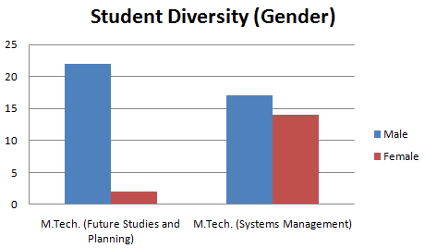
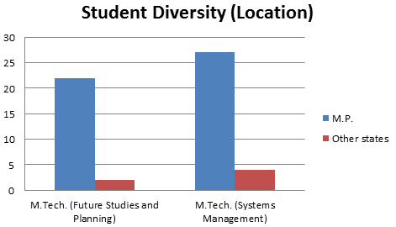
Student Profile (2012-13)

Slide 11
Curriculum Revision
Regulatory bodies
All India Council For Technical Education (AICTE), New Delhi
Institute/Research Organization
IIT Delhi
Industry Experts
Experts from reputed IT Companies e.g. Tech Mahindra, Oracle.
IIT Bombay
CSIR-CMMCS

Slide 12
Process of Curriculum Revision-Annually
Curriculum Revision
Feedback from stakeholders
Employability
Global scenario
Syllabi of various Universities and National Level Institutions
Restructuring and Revision of syllabi (2011-12)
M.Tech.(FSP)
M.Tech.(SM)
Revision of syllabi (2012-13)
M.Tech. (FSP/SM)
Revision of Syllabi (2013-14)
In Process
Ph.D. Entrance exam
Ph.D. Course work

Slide 13
Academic Flexibility
Elective subjects
4 Electives in First Semester.
Choice Based Course
1 choice based course from all M.Tech. courses of other departments in Second Semester.
Enrichment courses
Soft skills Personality Development
Internship-cum-Project
1 year Internship cum project facilities to students in second year of M.Tech (FSP/SM).
3 Electives in Second Semester.
Total available electives in each semester: 12
Technical Communication.
Interview & Resume Preparations
Notes:
Latera

Slide 14
Curriculum Feedback System
Feedback on curriculum
External Experts
Students
Faculty
Alumni

Slide 15
Admission Process
M.Tech. Admissions through GATE.
Ph.D. Admission through DET.
Admission Through GATE & DET
Ph.D. (FSP)
M.Tech. (FSP/SM)

Slide 16
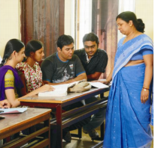
Teaching Learning & Evaluation
Induction and orientation programmes.
Enrichment courses, Seminars.
Identification of slow and fast learners.
Remedial classes for slow learners and research guidance to fast learners.
Teaching-Learning Process: Course plans, ICT enabled teaching, assignments, projects, lab. experiments.
Feedback from students, alumni and external experts.
Transparent evaluation process.
Declaration of result within 20 days.
Industrial visits.

Slide 17
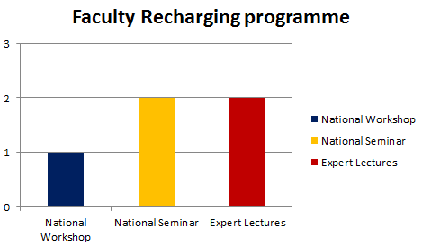
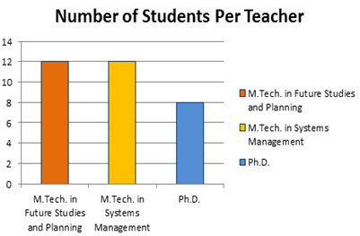
Teacher Quality
Faculty members having Ph.D.: 67%
Faculty members having M.Tech. degree: 33%
Faculty members from IITs: 33%

Slide 18
Research
Research Areas:
Systems Engineering, Environmental Management, Technology Forecasting and Assessment, System Dynamics, Mathematical Modelling and Simulation, Econometrics, Science Communication, etc.
Research Publications(2008-13): 29
Number of papers published in peer reviewed journals: 12
Conferences: 12; National: 9; International: 3
Chapters in Books: 5
Citations: 55; h-index: 4; Aver. Impact Factor: 0.6
Research Publications by M.Tech. students: 13
Journals: 8
Conferences: 5

Slide 19
Research
No. of Ph.D.s Awarded during 2009-13: 08
No. of Ph.D. students submitted theses: 09
No. of On-going Ph.D.s: 15

Slide 20
Projects
Project Title | Funding Agency | Grant Received (Rs.)
GIS Based Forest Decision Support System for Sustainable Biomass Production and Carbon Sequestration in Forests of Malwa Region of Madhya Pradesh Dr. V.B.Gupta (PI) | DST, New Delhi | 29,98,970/- (3½ Years)
P.G. Diploma Course in Science Journalism through Distance Education Dr. V.B.Gupta (Co-ordinator) | NCSTC, DST, New Delhi | 25,00,000/- (5 Batches)
Masters Programme in Science Communication Dr. V.B.Gupta (Co-ordinator) | NCSTC, DST, New Delhi | 25,20,000/- (4 Batches)
Total Grant: Rs. 80,18,970/-

Slide 21
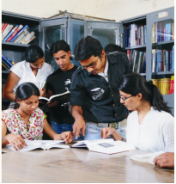
School’s Library
Printed books-titles (633)
Volumes (1210)
e-books-140
Journals (more than 1400) available on LAN

Slide 22
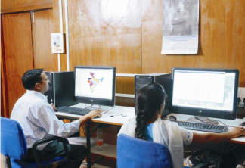
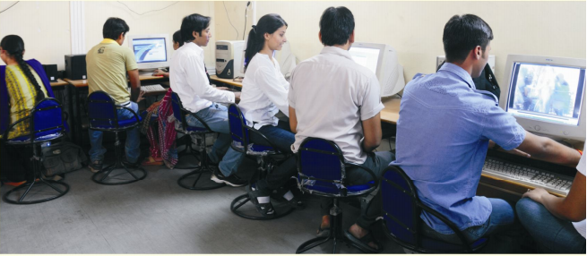
Laboratories
System Lab
Forecasting Lab
GIS Lab
Research Lab

Slide 23
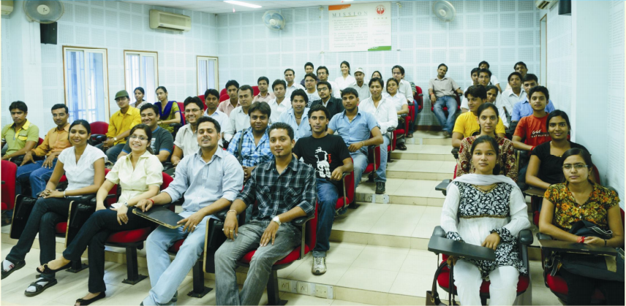
Infrastructure
Internet facilities for staff and students: Available on 40 computers
4 Class rooms with ICT facility
1 Seminar Hall
2 Students’ laboratories
2 Research laboratories
Other facilities: separate common rooms for girls and boys, Pantry Room, Committee Room, Exam Control Room.

Slide 24
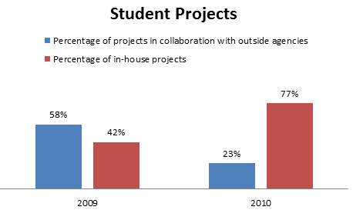
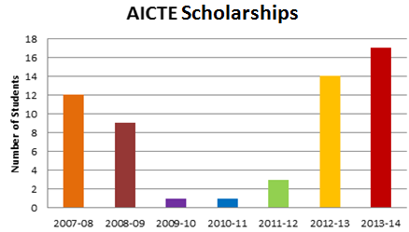
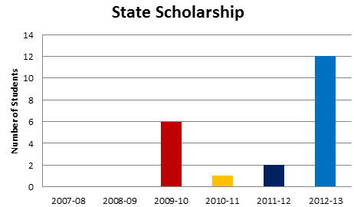
Student Support and Progression
Student Mentoring
Student Support
AICTE Scholarship
State Scholarship
Student Projects
Out side Agencies
In-House

Slide 25
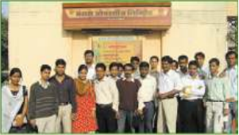
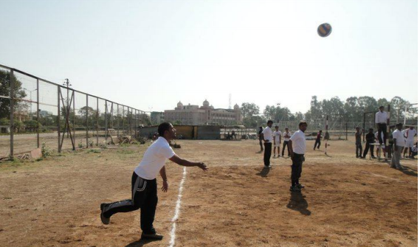
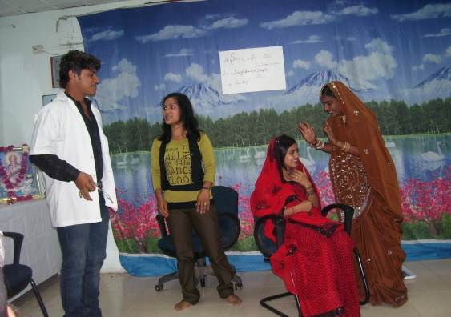
Student Activities
Expert Lectures
Industrial Visit
Seminar/Workshop
Sport Activities
Cultural Activities-Punkhudi

Slide 26
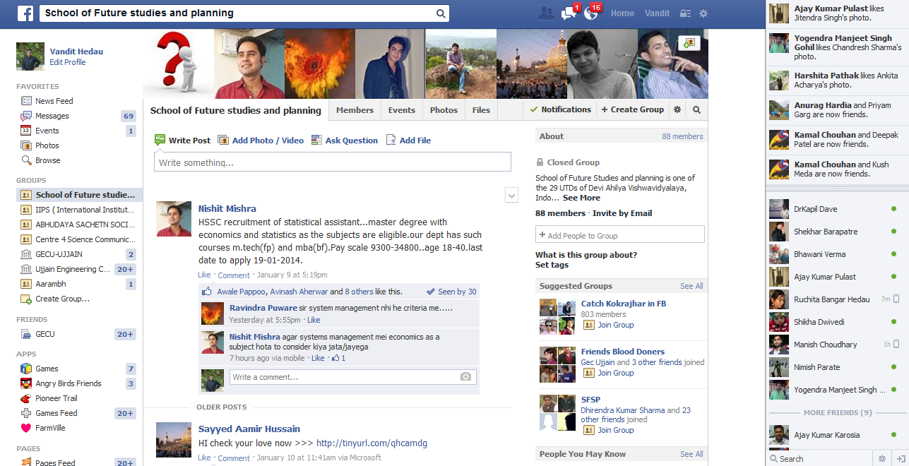
Students’ Social Connectivity

Slide 27
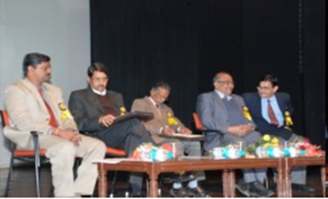
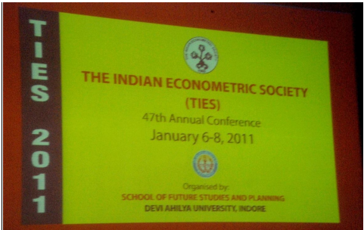
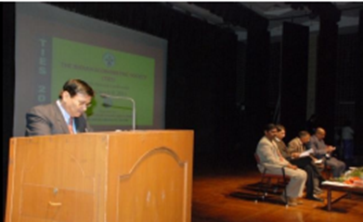
Conferences
47th Annual Conference of The Indian Econometric Society, School of Future Studies and Planning, Devi Ahilya University, Indore, 6-8 Jan. 2011.

Slide 28
Conferences
Outstanding participants:
Dr. Y.V.Reddy, Former Governor, RBI, New Delhi.
Dr. K.L.Krishna, Former Director, Delhi School of Economics
Dr. Arvind Panagariya, Columbia University, USA
Dr. Vinod,USA
Dr. N.R.Bhanumurthy, NIPFP, New Delhi
Dr. Subir Gokarn, Deputy Governor, RBI.
Dr. Atul Sharma, Former member, Finance Commission, New Delhi
Dr. B.H.Dholakiya, Director, IIM, Ahemdabad.

Slide 29
Invited Talks & Seminars
External Experts Delivered Talks:
Dr. B.B.Bhattacharya, Former V.C., JNU, New Delhi.
Dr. C.L.Jain, St. Johns University, New York
Dr. H.N.Dutta, Former Scientist G, NPL, New Delhi
Dr. P.K.Choubey, IIPA, New Delhi
Dr. V.K.Jain, V.C., Doon University, Dehradun
Dr. R.N.Yadava, CSIR-AMPRI, Bhopal
Seminar:
Dr. P.Ram Babu, CEO, GC Advisors, Mumbai
on Nov. 06, 2014
“International Day for Preventing the Exploitation of the Environment in War and Armed Conflict”.

Slide 30
Placements
Internship & Placement Committee (Department Level).
Internship-cum-project Placements
List of Recruiters:
ABB, CantorC02e, Ecolutions, Hindustan Unilever, IBM, Indian Railway, NISTADS, RCM Aeroservices Canada, Reliance Energy, GE, Surtel Technologies USA, One97 Communications, TCS, Infosys Labs, Tech. Mahindra, 3iInfotech Chennai, Bajaj Allianz, CSIR-AMPRI, Bhopal, IIM Indore.

Slide 31
Governance, Leadership and Management
The School has formed following committees to govern and manage different activities:
Anti-Ragging Committee
Anti-Ragging Squad
Curriculum Design and Review Committee
Departmental Committee
Departmental IQAC
Departmental Purchase Committee
Examination and Result Committee
Grievances Redressal Cell
Internship and Placement Committee
Programme Monitoring Committee
School Industry Interaction Committee
Sports and Cultural Committee

Slide 32
Innovations and Best Practices
Developing the systems thinking.
Capacity building for professionals to invoke paradigm shift in organizations.
Capacity building of M.Tech. students to orient them towards research as evidenced by their research publications.
Computerized Accounting.

Slide 33
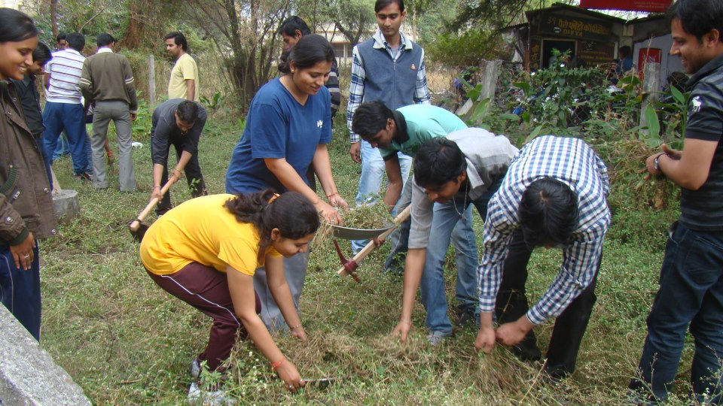
Environmental Consciousness
Plantation
Activity round the year
Cleanliness drive
Shram daan

Slide 34
Future Plans
To establish a Centre for Climate Research through collaboration with other Schools of Studies in the campus.
To start consultancy services in following areas:
Forecasting, Clean Development Mechanism, Environmental
Management, Business Data Analysis, Sustainability
New academic programmes:
M.Tech. in Mathematical Modelling and Simulation
M.Sc. in Data Science & Analytics
Collaborations with the reputed research organizations, and industries.
Enhance Campus Placement.
Use of Energy Efficient Technologies.
Development of Infrastructure:
Virtual Laboratories
Infrastructure-building and labs.

Slide 35
Thank You

